Slide 1
CS544 Final Project
David L. Capps

Slide 2
Preparing the data
Found a dataset online
#https://vincentarelbundock.github.io/Rdatasets/datasets.html ais.csv
# getting directory to place data
getwd()
#Reading File
x1 <- read.csv(file="ais.csv", header=TRUE, sep=",")
#displaying data
x1

Slide 3
Preparing the data
> x1
X rcc wcc hc hg ferr bmi ssf pcBfat lbm ht wt sex sport
1 1 4.0 7.5 38 12 60 21 109 19.8 63 196 79 f B_Ball
2 2 4.4 8.3 38 13 68 21 103 21.3 59 190 74 f B_Ball
3 3 4.1 5.0 36 12 21 22 105 19.9 55 178 69 f B_Ball
4 4 4.1 5.3 37 13 69 22 126 23.7 57 185 75 f B_Ball
5 5 4.4 6.8 42 14 29 19 80 17.6 53 185 65 f B_Ball

Slide 4
Preparing the data
# Taking the relevant columns from the dataset and creating new dataframe
aus.athletes <- data.frame(x1$wcc, x1$bmi, x1$ht,
x1$wt, x1$sex, x1$sport)
# Changing headings of data frame
col_headings <- c('WBC','BMI','HT','WT','sex','sport')
names(aus.athletes) <- col_headings

Slide 5
Analyzing the data
Do the analysis as in Module3 for at least one categorical variable and at least one numerical variable. Show appropriate plots for your data.
Getting number of participants by gender and sport
aus.athletes
x <- table(aus.athletes$sex, aus.athletes$sport)
dimnames(x) <- list(Gender = rownames(x), Sport = colnames(x))

Slide 6
Analyzing the data
Sport
Gender B_Ball Field Gym Netball Row Swim T_400m T_Sprnt Tennis W_Polo
f 13 7 4 23 22 9 11 4 7 0
m 12 12 0 0 15 13 18 11 4 17
> # get number by gender
> margin.table(x,1)
Gender
f m
100 102
> # get number by sport
> margin.table(x,2)
Sport
B_Ball Field Gym Netball Row Swim T_400m T_Sprnt Tennis W_Polo
25 19 4 23 37 22 29 15 11 17

Slide 7
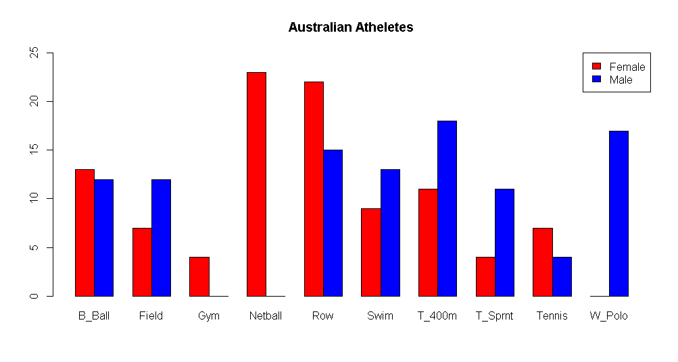
Analyzing the data

Slide 8
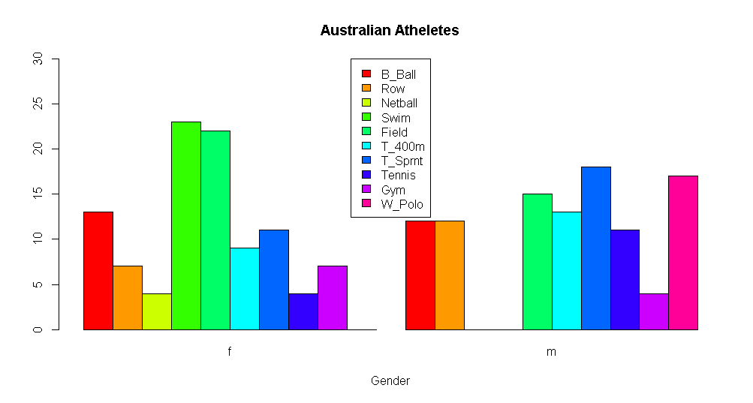
Analyzing the data

Slide 9
Analyzing the data
stem(height)
The decimal point is 1 digit(s) to the right of the |
14 | 99
15 |
15 | 6789
16 | 22334
16 | 5567788999
17 | 000001111112222233333333444444444444
17 | 5555555566666667777788888888899999999
18 | 0000000000000000011111112233333333344444
18 | 555555555566666666677778888999999
19 | 00011111222333333334444
19 | 555567889
20 | 03
20 | 9

Slide 10
Analyzing the data
> f = fivenum(height)
[1] 149 174 180 186 209
> whiskers <- c(f[2] - 1.5*(f[4] - f[2]), f[4] + 1.5*(f[4] - f[2]))
> whiskers # < 156 > 204 outliers are 149 149 and 209
[1] 156 204
> height[height < whiskers[1]]
[1] 149 149
> height[height > whiskers[2]]
[1] 209

Slide 11
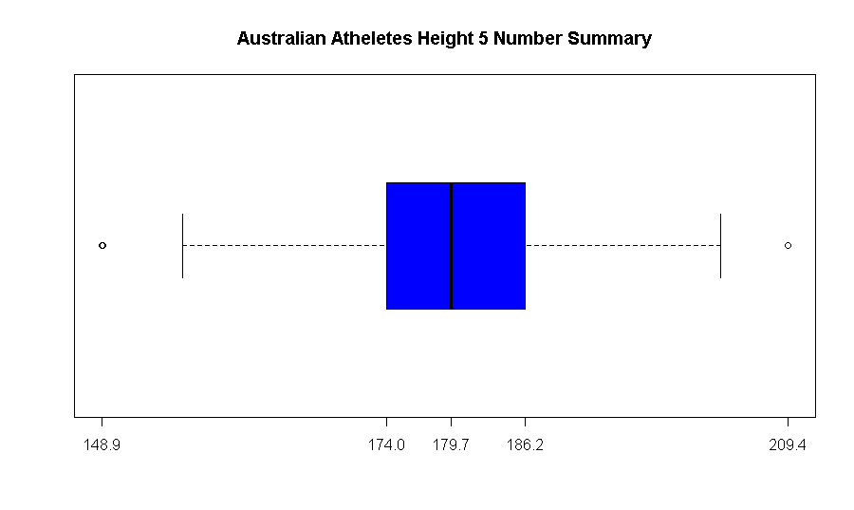
Analyzing the data

Slide 12
Analyzing the data
# Pick one variable with numerical data and examine distribution of the data.
> WBC <- aus.athletes$WBC # White Blood Count of Atheletes
> WBC
[1] 7.5 8.3 5.0 5.3 6.8 4.4 5.3 5.7 8.9 4.4 5.3 7.3 7.8 6.2 6.0 5.8 7.3 8.3 8.1
[20] 6.9 5.7 3.3 9.5 6.4 5.8 5.6 5.8 7.6 7.5 6.6 6.4 10.1 6.6 5.9 7.3 13.3 6.0
[39] 6.4 5.8 6.1 5.0 6.6 5.5 9.7 10.6 6.3 9.1 9.6 5.1 10.7 10.9 9.3 8.4 6.9 8.4
[58] 8.5 5.5 5.9 4.9 8.1 8.3 5.8 5.3 5.1 7.0 9.5 9.5 5.8 6.8 9.0 7.1 9.3 7.5

Slide 13
Analyzing the data
#Calculate mean of WBC
> mu <- mean(WBC)
> mu
[1] 7.1
> n <- length(WBC) # number of values
> # Calculate Standard Deviation
> std <- sd(WBC)
> std
[1] 1.8
> sigma <-sqrt((std ^ 2) * ((n - 1) / n))
> sigma
[1] 1.8

Slide 14
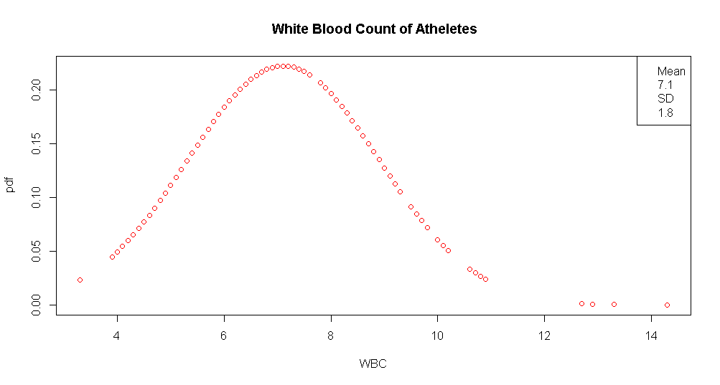
Analyzing the data
pdf <- dnorm(WBC, mean = mu, sd = sigma)

Slide 15
Analyzing the data
> # CDF probability atheletes WBC within mean of 7.1 is 0.5 or 50%
> pnorm(mu, mean = mu, sd = sigma)
[1] 0.5
> #The cumulative probability of a WBC within less than the 3rd SD,
> mu - 3*sigma
[1] 1.7
> pnorm(mu - 3*sigma, mean = mu, sd = sigma)
[1] 0.0013

Slide 16
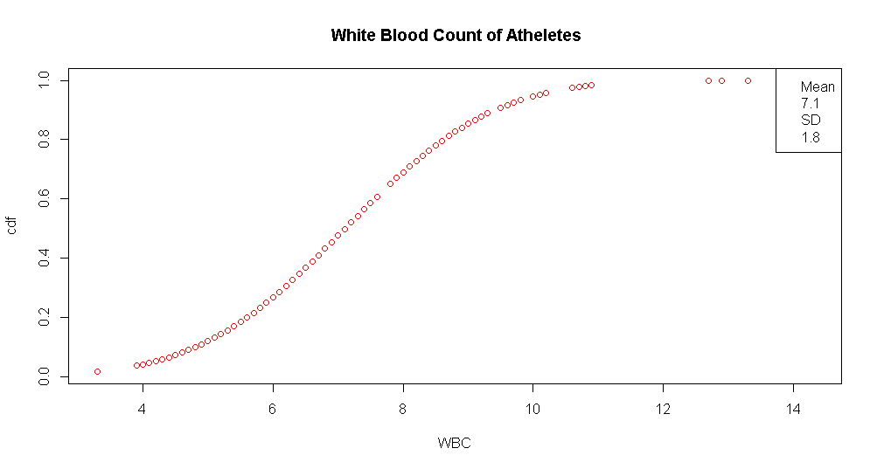
Analyzing the data
cdf <- pnorm(WBC, mean = mu, sd = sigma)

Slide 17
Analyzing the data
# the quantile function is reverse of pnorm, you give it probability and it
returns the number for that probability. in this case the mean
> qnorm(0.5, mean = mu, sd = sigma)
[1] 7.1
> # the reverse of mu - 3*sigma from above
> qnorm(0.0013, mean = mu, sd = sigma)
[1] 1.7

Slide 18
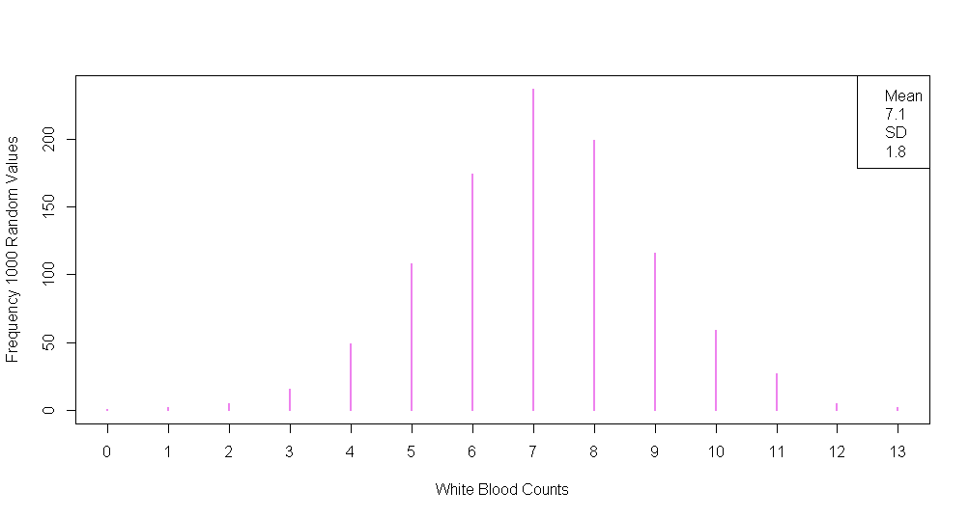
Analyzing the data
x <- rnorm(1000, mean = mu, sd = sigma) > x <- round(x)

Slide 19
Analyzing the data
# Draw various random samples of the WBC data and show the applicability of the Central Limit Theorem for this variable.
> set.seed(100)
> # random 1000 samples from mean and standard deviation of WBC
> x <- rnorm(1000, mean = 7.1, sd = 1.8)
> options(digits=2)
> mean(x)
[1] 7.1
> sd(x)
[1] 1.9

Slide 20
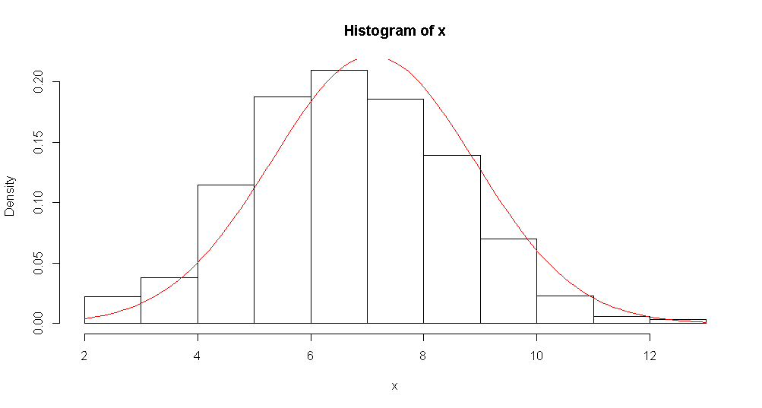
Analyzing the data
Slight Right Skew
x <- rnorm(1000, mean = 7.1, sd = 1.8)

Slide 21
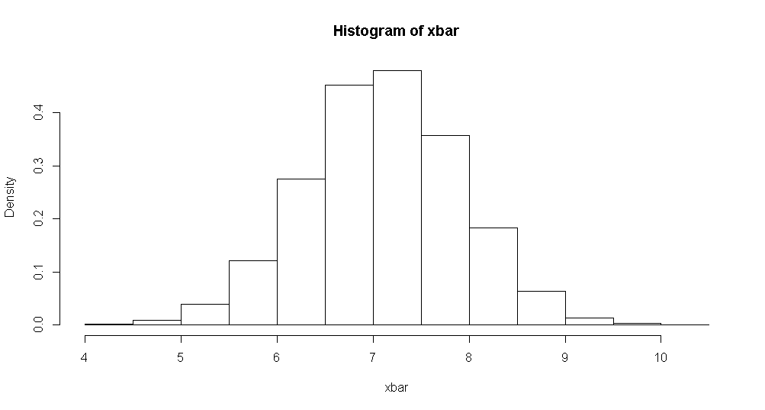
Analyzing the data
histogram of 10000 random samples with sample size 5
Close to normal distribution

Slide 22
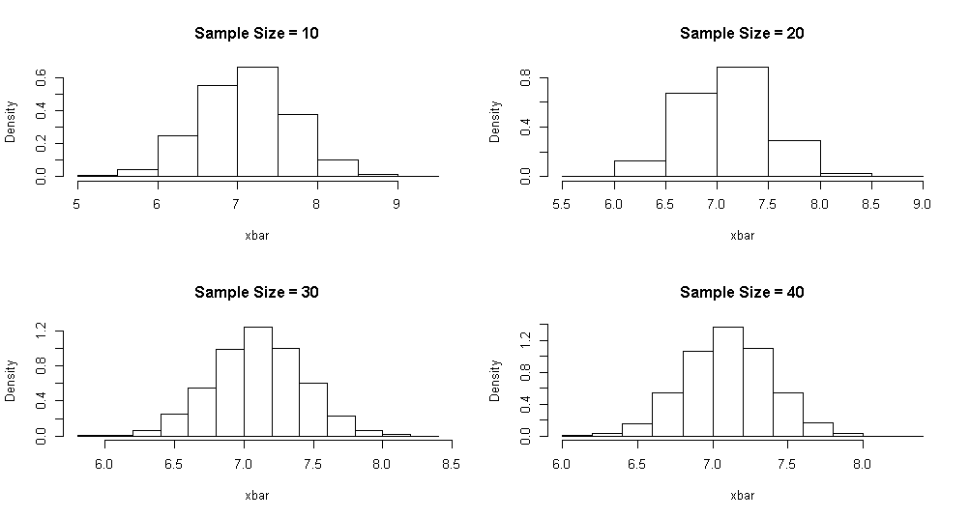
Analyzing the data
for (size in c(10, 20, 30, 40)) {
+ for (i in 1:samples) {
+ xbar[i] <- mean(rnorm(size,
+ mean = 7.1, sd = 1.8))
+ }
Sample Size = 10 Mean = 7.1 SD = 0.57 Sample Size = 20 Mean = 7.1 SD = 0.4 Sample Size = 30 Mean = 7.1 SD = 0.33 Sample Size = 40 Mean = 7.1 SD = 0.29

Slide 23
Analyzing the data
The larger the sample size the more normal the distribution gets
Sample size10 and 20 are little right skewed 30 and 40 are closer to the Normal distribution.
Proving Central Limit Theorem

Slide 24
Analyzing the data
Sample drawn using simple random sampling without replacement. Showing the frequencies for each Sport. Showing the percentages of these with respect to the entire dataset.
> length(unique(sample.1$sport))
[1] 7
> length(table(aus.athletes$sport))
[1] 10

Slide 25
Analyzing the data
#15 samples drawn using systematic sampling. Frequencies for each sport. percentages of these with respect to the entire dataset.
> #9 out of 10 sports were sampled
> length(unique(sample.3$sport))
[1] 9
> length(table(aus.athletes$sport))
[1] 10

Slide 26
Analyzing the data
Calculating the inclusion probabilities using the WBC variable. Showing the sample drawn using systematic sampling. Showing the frequencies for each sport.
# 8 out of 10 sports sampled
> length(unique(sample.4$sport))
[1] 8
> length(table(aus.athletes$sport))
[1] 10

Slide 27
Analyzing the data
Ordering data using the sport variable. Drawing a stratified sample using proportional sizes based on sport variable. Showing frequencies for each.
> order.index <- order(aus.athletes$sport)
> data <- aus.athletes[order.index, ]
10 out of ten sports sample due to stratification

Slide 28
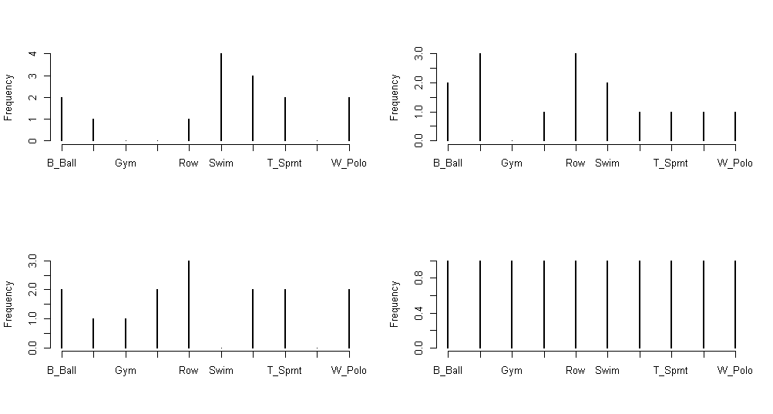
Analyzing the data
s <- srswor(sample.size, nrow(aus.athletes))
s <- seq(r, by = k, length = n)
st <- strata(data, stratanames = c("sport"),
size = sizes, method = "srswor")
s <- UPsystematic(pik)

Slide 29
Analyzing the data
P1 B_Ball Field Gym Netball Row Swim T_400m T_Sprnt Tennis W_Polo
0.12 0.09 0.02 0.11 0.18 0.11 0.14 0.07 0.05 0.08
P B_Ball Field Gym Netball Row Swim T_400m T_Sprnt Tennis W_Polo
0.13 0.07 0.00 0.00 0.07 0.27 0.20 0.13 0.00 0.13
P5 B_Ball Field Gym Netball Row Swim T_400m T_Sprnt Tennis W_Polo
0.13 0.07 0.07 0.13 0.20 0.00 0.13 0.13 0.00 0.13
P8 B_Ball Field Gym Netball Row Swim T_400m T_Sprnt Tennis W_Polo
0.13 0.10 0.01 0.11 0.18 0.11 0.14 0.07 0.06 0.08

Slide 30
Analyzing the data
Comparing the means of WBC variable for these four samples with the entire data.
> mean(aus.athletes$WBC) [1] 7.1 # mean WBC entire data set
> mean(sample.1$WBC) [1] 7.2
> mean(sample.3$WBC) [1] 7.3
> mean(sample.4$WBC) [1] 7.7
> mean(sample.5$WBC) [1] 6.5
> # The 1st 3 means are pretty close, 7.1 is mean for dataset sample.1 = 7.2 ,
> #sample.3 = 7.3, the last 2 means are both .6 from dataset mean of 7.1
> #sample.4 = 7.7, and sample.5 = 6.5.

Slide 31
Analyzing the data
For confidence levels of 80 and 90, show the confidence intervals of the mean of numeric variable for various samples and compare against population mean
> # Using BMI of atheletes for this task
> mu <-mean(aus.athletes$BMI)
> mu [1] 23
> sigma <-sd(aus.athletes$BMI)
> sigma [1] 2.9
> samples <- 5000
> sample.size <- 50
> x1 <- rnorm(samples, mean = mu, sd = sigma)

Slide 32
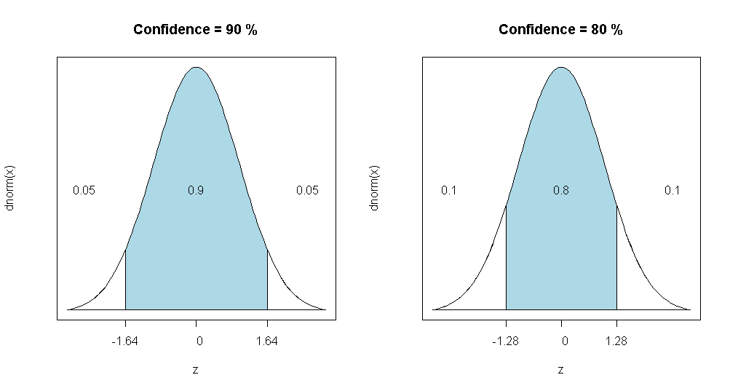
Analyzing the data
alpha <- 1 - 90/100
+ z <- qnorm(1 - alpha/2)
alpha <- 1 - 80/100
+ z <- qnorm(1 - alpha/2)

Slide 33
Analyzing the data
90 percent confidence intervals 80 percent confidence intervals
1: xbar = 22.20, CI = 20.10 - 24.30 1: xbar = 22.40, CI = 20.76 - 24.04
2: xbar = 21.60, CI = 19.50 - 23.70 2: xbar = 23.00, CI = 21.36 - 24.64
3: xbar = 21.40, CI = 19.30 - 23.50 3: xbar = 23.00, CI = 21.36 - 24.64
4: xbar = 22.00, CI = 19.90 - 24.10 4: xbar = 23.00, CI = 21.36 - 24.64
5: xbar = 23.40, CI = 21.30 - 25.50 5: xbar = 23.60, CI = 21.96 - 25.24
6: xbar = 23.20, CI = 21.10 - 25.30 6: xbar = 23.80, CI = 22.16 - 25.44
7: xbar = 22.00, CI = 19.90 - 24.10 7: xbar = 22.20, CI = 20.56 - 23.84
8: xbar = 21.60, CI = 19.50 - 23.70 8: xbar = 22.00, CI = 20.36 - 23.64
9: xbar = 22.80, CI = 20.70 - 24.90 9: xbar = 24.40, CI = 22.76 - 26.04
10: xbar = 24.20, CI = 22.10 - 26.30 10: xbar = 23.40, CI = 21.76 - 25.04

Slide 34
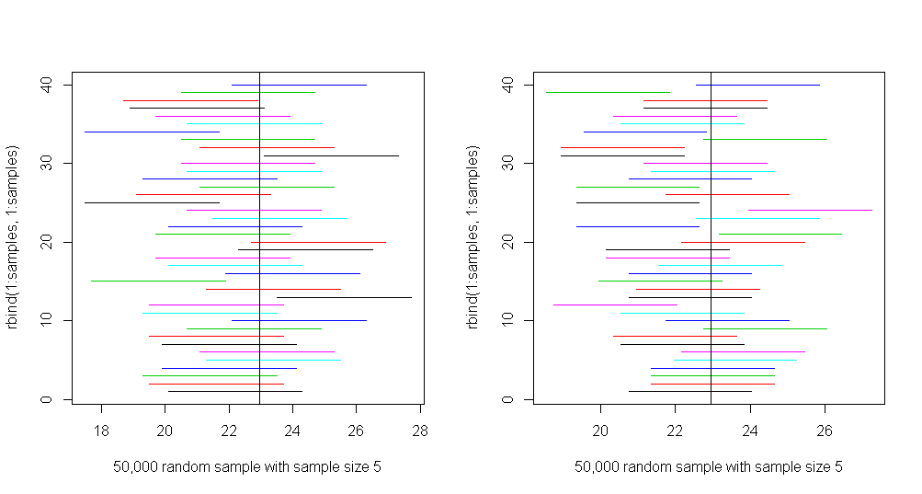
Analyzing the data
90% Confidence Interval
80% Confidence Interval

Slide 35
Analyzing the data
The End
???????????

